Slide 1
Am I a good Leader?
Chrispin Cheung

Slide 2
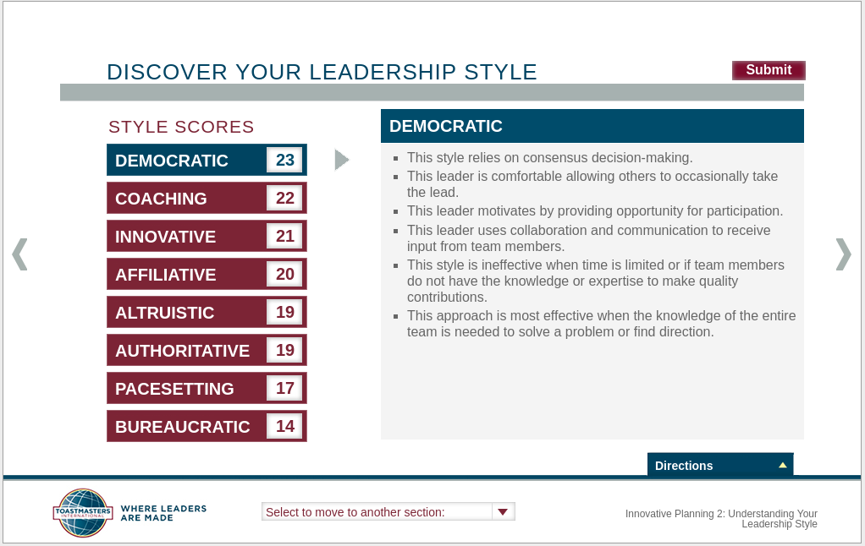

Slide 3
Attributes of A Successful Leader
Effective Communicator
Leads by example
Optimistic
Open-minded
Demonstrates Integrity

